Slide 1
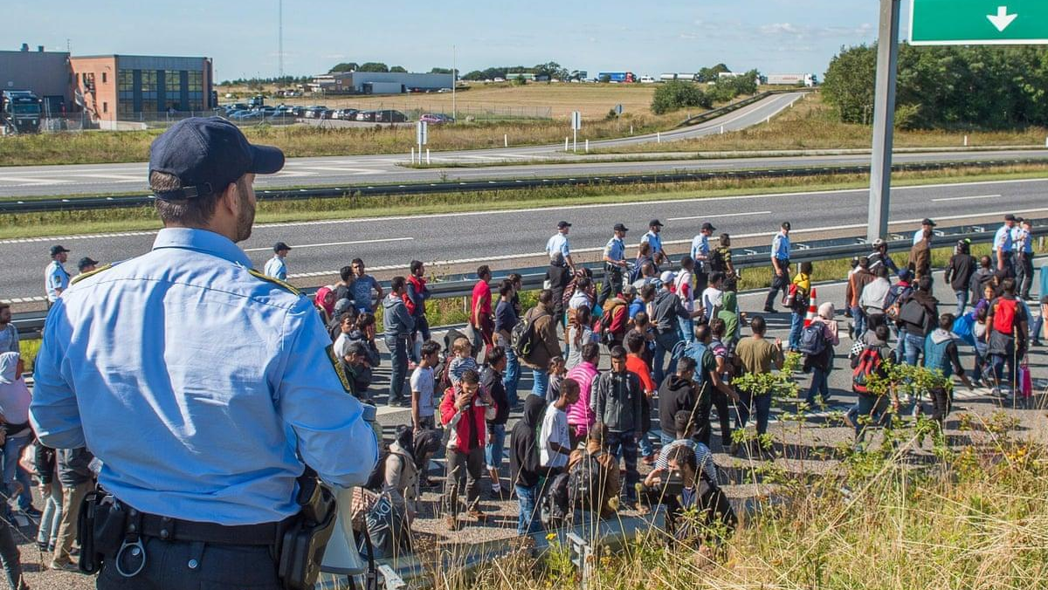
Refugee/migrant history
in Denmark
By: Daniel, Louise, Nico, Mert and Natasha.
Holbæk 10. klassecenter, Denmark
Presented in Athens, Greece

Slide 2
Slide 1
In the 1960s, Denmark found itself for the first time in a situation where industry exports for larger amounts than agriculture. Unemployment disappeared, there were full employment and in some professions a gradual shortage of labor. More and more women became employed and there was a demand for foreign labor. As a result, in the late 1960s and early 1970s, there was an immigration of workers, especially from Yugoslavia, Turkey and Pakistan.
The Danish industry lacked manpower, and the foreigners got the jobs that could not be filled with Danes. In 1970 there were approx. 20,000 foreign workers in Denmark. The vast majority only intended to live and work in Denmark for a few years. Then they wanted to return to their homeland. But once the children came here and started school, the planned journey home was rarely realized.
In the 1960s, Danes talked about “guest workers”.
But as early as the 1970s, the term "foreign workers" began to become more common as the term for the immigrants who had been asked to come here. Many of the immigrants felt lonely; they did not understand Danish and had difficulty getting in touch with Danes.

Slide 3
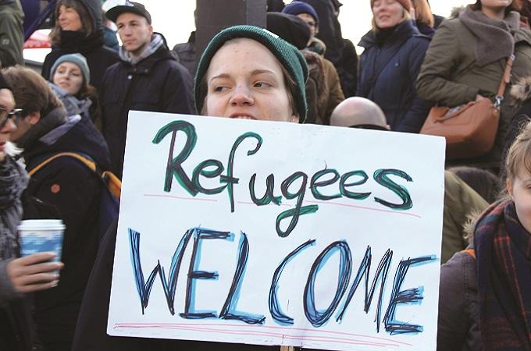
Jobs and opportunities for migrant workers:
Unwanted jobs:
In the 1960s, Denmark found itself for the first time in a situation where industry exports for larger amounts than agriculture…
Refugees escaped to Denmark:
The Danish industry lacked manpower, and the foreigners got the jobs that could not be filled with Danes…
Guest workers:
In the 1960s, Danes talked about “guest workers”.
But as early as the 1970s…
By: Daniel

Slide 4
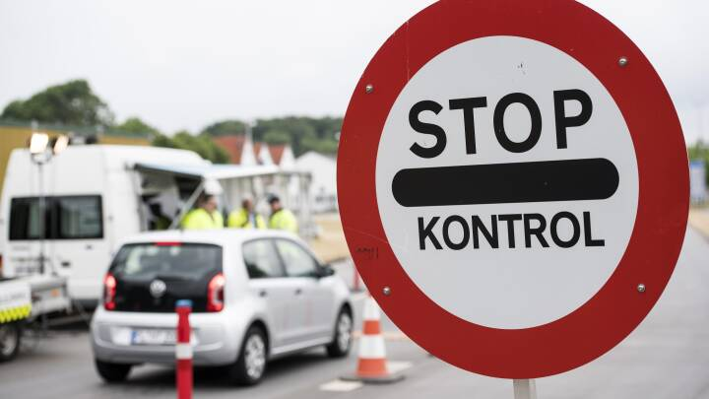
Restriction
By: Louise

Slide 5
Most EU countries introduced a more or less restrictive immigration ban in the 1970s. In Denmark, this happened in 1973. This meant that you had to be a refugee to obtain a permanent residence permit. The immigration stop also worked at the municipal level, but there it was not only about immigrants, but also about refugees. In 1983, the Aliens Act was passed, and it was tightened for refugees in 1986. Several municipalities, which had a significant concentration of citizens on transfer income, began to protest that they should continue to receive immigrants and refugees in their municipalities.

Slide 6
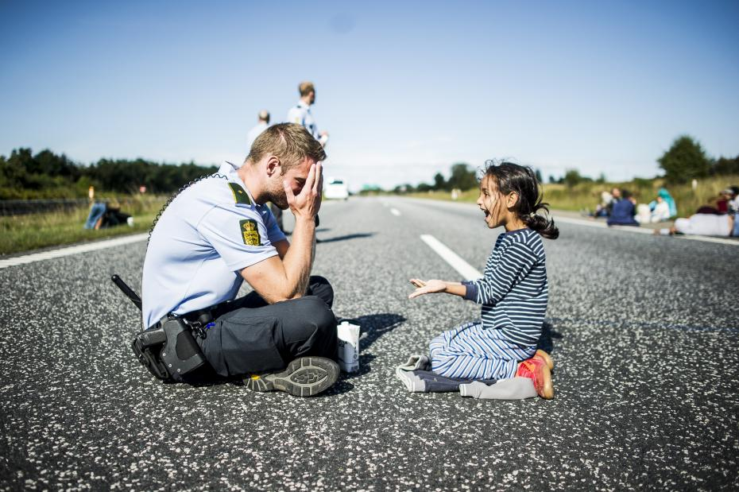
Refugee Act.
Made by Natasha

Slide 7
Refugee Act
Refugees who came to Denmark did not give problems in the period from the 1950s until the beginning of the 1980s. Denmark was proud of its humanitarian attitude and tolerance and welcomed Hungarian refugees after the 1956 uprising, Polish refugees in 1969-70, refugees from Chile in 1973-74 and Vietnamese boat refugees around 1980.
Approx. In the period 1984-86, on the other hand, 10,000 refugees from Iran, Lebanon and Sri Lanka turned upside down both Danish refugee policy and the population's relationship to both refugees and immigrants.
Many Danes began to perceive the foreigners as competitors in the labor, education and housing market, and as some who came to spy on the Danish welfare state. Against this background, the Parliament adopted a new refugee policy in 1986, making Denmark one of the most difficult countries accessible to refugees, instead of one of the most liberal. In the following years, the legislation in this area was repeatedly amended. On 14 December 1994, the so-called "Bosnian law" was passed in the Parliament. The law was part of a compromise between the liberal and Conservatives and, on the other hand, the Social Democrats and the other governing parties.

Slide 8
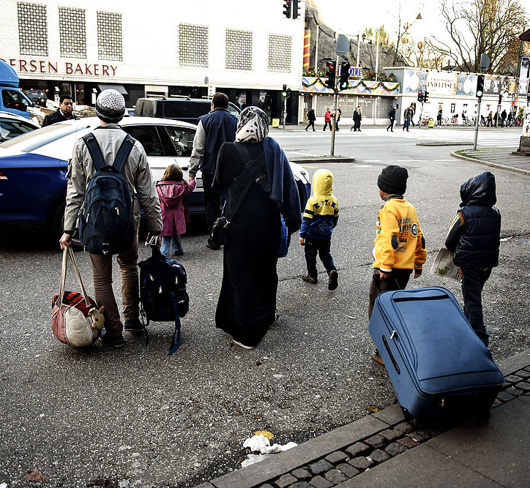
resettlement refugees in Denmark

Slide 9
A total of 614,000 immigrants and refugees live in Denmark today. This may sound like a lot (of a population of 5,8 mil people), but in recent years refugees have only made up 1-2% of all foreigners who received a residence permit in Denmark. And over time, many refugees get Danish citizenship, and their children grow up and become native Danes. It is difficult to imagine Denmark today without the refugees from Hungary, Vietnam, Chile, Afghanistan, Sri Lanka, Iran, Bosnia, etc. who have become an important part of society.
Refugees who were granted asylum in Denmark
Year In total Largest groups
1956-59 1.676 (1.470 Hungary)
1960-64 401 (143 Yugoslavia)
1965-69 2.009 (1.309 Poland)
1970-74 3.299 (2.055 Poland)
1975-79 2.620 (1.502 Vietnam, 498 Chile)
1980-84 4.369 (2.198 Vietnam)
1985-89 26.352 (7.339 Iran, 5.659 no nationality, 4.354 Sri Lanka)
1990-94 17.191 (3.606 Irak, 3.520 Somalia, 3.359 no nationality)
1995-99 44.260 (19.809 Bosnien-Herc., 6.906 Iraq, 6.107 Somalia)
2000-04 19.527 (5.174 Afghanistan, 4.921 Iraq)
2005-09 6.349 (979 Iraq, 650 Burma)
2010-14 14.397 (3.004 Syria, 1.764 Afghanistan, 1.395 Iran)
2015-19 22.583 (13.357 Syria, 5.011 Eritrea, 1,923 no nationality, 1.744 Iran)

Slide 10
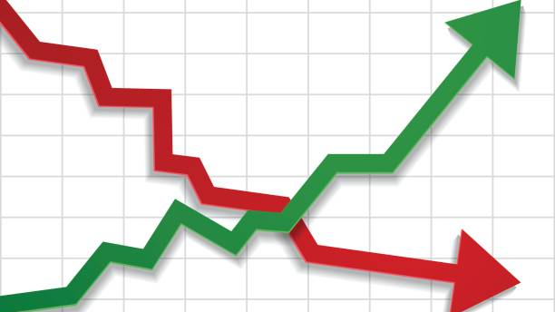
Fluctuation of refugees.
numbers of refugees since 1978 to 2020…

Slide 11
The number of refugees has fluctuated a lot over the years and the nationalities have varied widely. Some nationalities have arrived in a very short period (for example Chileans and Bosnians) and others have arrived over a longer time span (for example Afghans and Iraqis). During recent years, Syrians, Eritreans and Iranians have been the largest groups.
Resettlement refugees (quota refugees) have been chosen from very different countries and from changing criteria. Since 1978 Denmark has received a quota of 500 a year from the UN, but in the years 2016-18 we did not accept any. In 2019 we received only 31, and in 2020 it was 200.

Slide 12
